Slide 1

Customer Churn Prediction

Slide 2
Presentation on​​:
Performance Evaluation of Various Classification Techniques for Customer Churn Prediction in E-commerce
Presented By: -​​
Abhinav Dixit- 212120029
Ashu Bhatt. – 212120110
​​MCA IV Semester
Under the guidance of:​
Dr. Amit Bhagat

Slide 3
Project analysis slide 2
Contents
INTRODUCTION​
LITERATURE REVIEW​
PROPOSED OBJECTIVES​
MATERIALS AND METHOD​S
RESULTS
CONCLUSIONS

Slide 4

Project analysis slide 2
Introduction
Customer churn is the percentage of customers who stopped purchasing our business’s products
or services during a certain period of time​.
Our customer churn rate indicates how many of our existing customers are not likely to make another
purchase from our business.

Slide 5
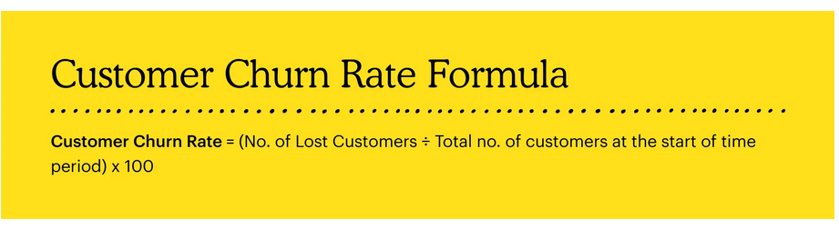
Project analysis slide 2
CONTD…​
Calculating customer churn rate can be done with a simple formula. To
calculate our customer churn rate, divide the number of customers we
lose during a certain time period by the number of customers we had at
the beginning of that time period, and then multiply to find the percentage.

Slide 6
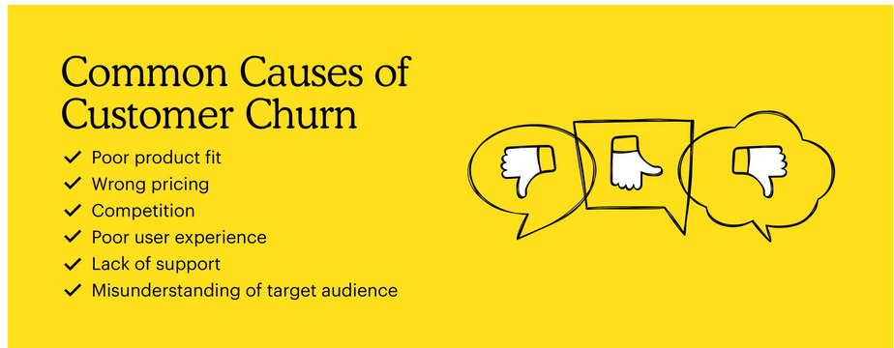
Project analysis slide 3
What causes customer churn?
Even the most successful of businesses will experience customer churn from time to time. However,
identifying exactly what’s causing our customers to leave can give us a better idea of what we need
to fix. Various factors can cause customer churn, including:

Slide 7
Project analysis slide 3
Why is analyzing customer churn important?
Customer churn analysis helps businesses understand the percentage of customers who are no longer
supporting them. It’s important to analyze our customer churn for various reasons, such as:​
Encourage growth
Boost profits
Improve brand identity
The more customers we have, the more money we’re going to make. But if we have to spend a lot of money on customer acquisition, they’re going to equal out and we won’t end up making any profit.
Understanding our customer churn rate is a great way to improve our brand identity. If we are losing a large percentage of customers, that could be a sign that our brand identity is lacking because your customers can’t relate to us.
A high customer churn rate indicates that your business is not growing at the rate it should be, which means we need to make some changes to our customer retention strategies..

Slide 8
Project analysis slide 2
LITERATURE REVIEW
Performance Evaluation of Various Classification Techniques for Customer
Churn Prediction in E-commerce
Telecom churn prediction and used techniques, datasets and performance measures: A review
Authors: Seema Baghla and Gaurav Gupta
Authors: Jain,Khunteta,Shrivastav
Summary: They demonstrated in this study that the use of Principal component analysis(PCA) and Neighbourhood component analysis (NCA) for features selection can improve the accuracy for the various prediction models for customer churn made by using various classification techniques.
Summary: This study provides a comprehensive view by extensively detailing work which has happened in telecom area and acts as a rich repositorory of all knowledge regarding churn prediction in telecom sector.

Slide 9
Project analysis slide 2
LITERATURE REVIEW
An extended support vector machine forecasting framework for customer churn in e-commerce
Combined artificial bee colony algorithm and machine learning techniques for prediction of online consumer repurchase intention
Authors: Xiabing Yu, Shunsheng Guo,Jun Guo and Xiaorong Huang
Authors: Kumar, Kabra, Mussada, Dash,Rana
Summary: They established a customer churn forecasting framework. For the imbalance and nonlinear of customer churn, they proposed an extended support vector machine (ESVM) by introducing parameters to tell the impact of churner, non-churner and nonlinear.
Summary: a hybrid approach is chosen with a combination of machine learning techniques and artificial bee colony (ABC) algorithm to predict online consumer repurchase intentions.

Slide 10
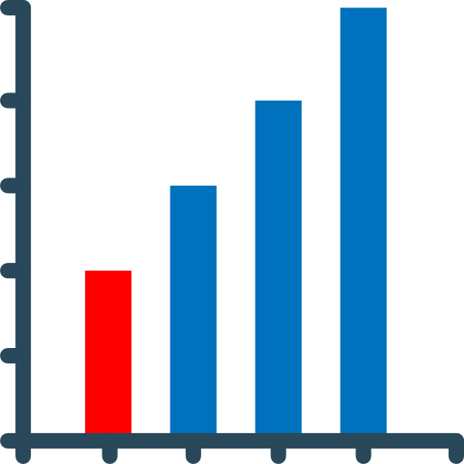



Project analysis slide 2
Proposed Objective
Working with the large Data Sets.
To predict Churn Customers by various classification techniques.
Increase the accuracy of the models.
Evaluate the performance of each model.

Slide 11
Project analysis slide 2
MATERIALS
Description of dataset
E Commerce Dataset.xlsx is collected from the Kaggle repositories.
The data set belongs to a leading online E-Commerce company. An online retail (E commerce) company wants to know the customers who are going to churn, so accordingly they can approach customer to offer some promos.
This dataset contains two two folders : Data dict and E- comm.
Data dict : It contains variables name we are going to use and what is means according to the company.
E-comm : It contains 19 columns of information related to user i.e CustomerID, Churn, PreferredLoginDevice, PreferredPaymentMode, HourSpendOnApp, NumberOfDeviceRegistered and many more.

Slide 12
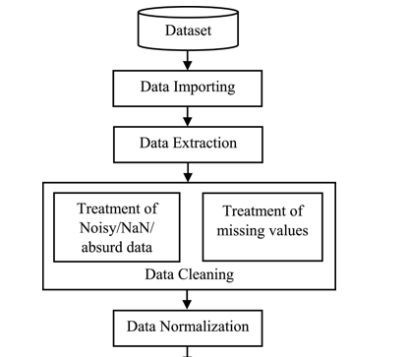
Project analysis slide 2
Flowchart 0f Proposed work

Slide 13
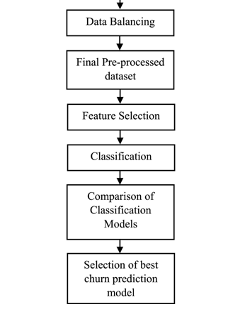
Project analysis slide 2

Slide 14
Project analysis slide 2
Data Cleaning
Remove Duplicates
Handle missing data
Data Cleaning
Fix structural errors
Handling Noisy data
Filter Unwanted Outliers
Handling NaN values

Slide 15
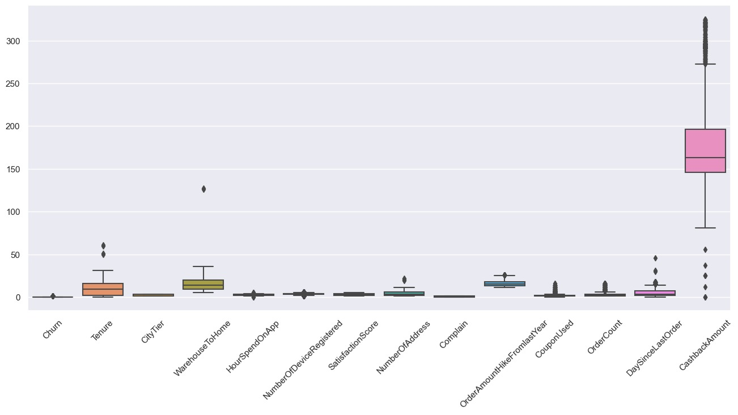
Project analysis slide 2
Visualising Outliers
Visual representation of outliers with BOXPLOT.
Before Cleaning :

Slide 16
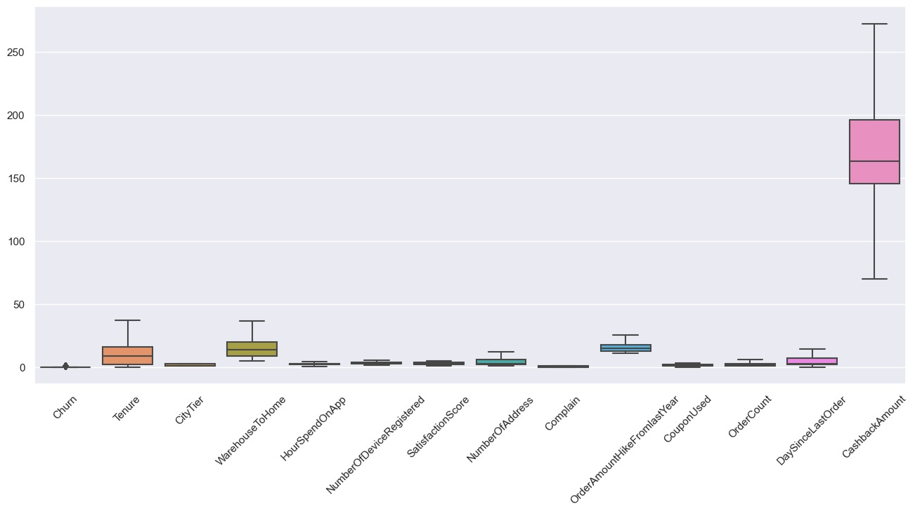
Project analysis slide 2
After Cleaning :

Slide 17
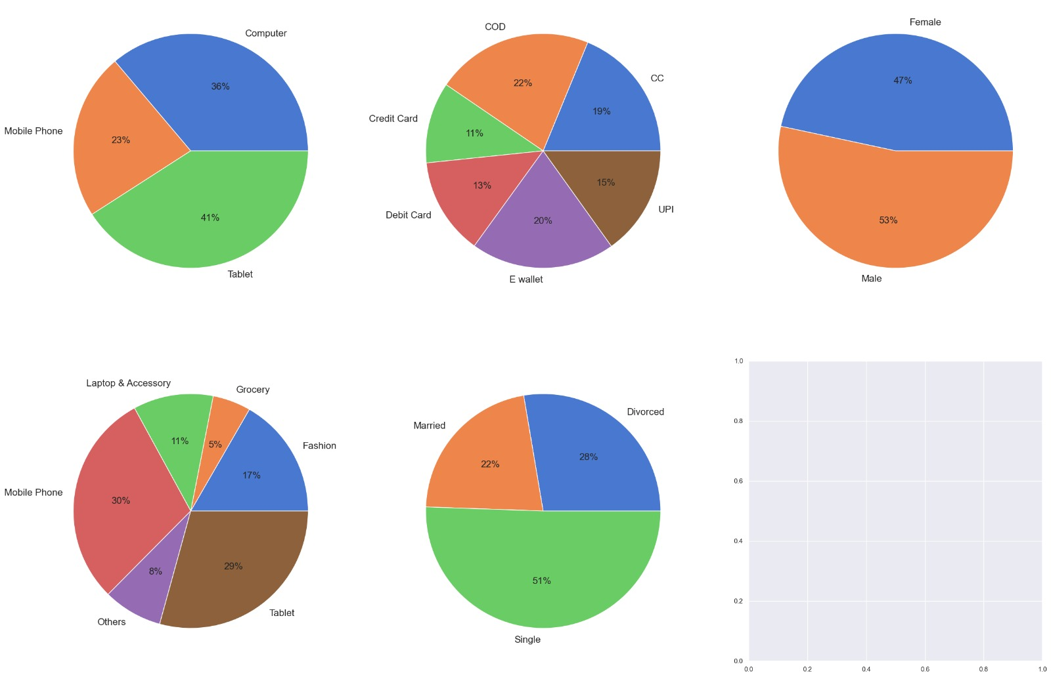
Project analysis slide 2
Analysing Data :

Slide 18
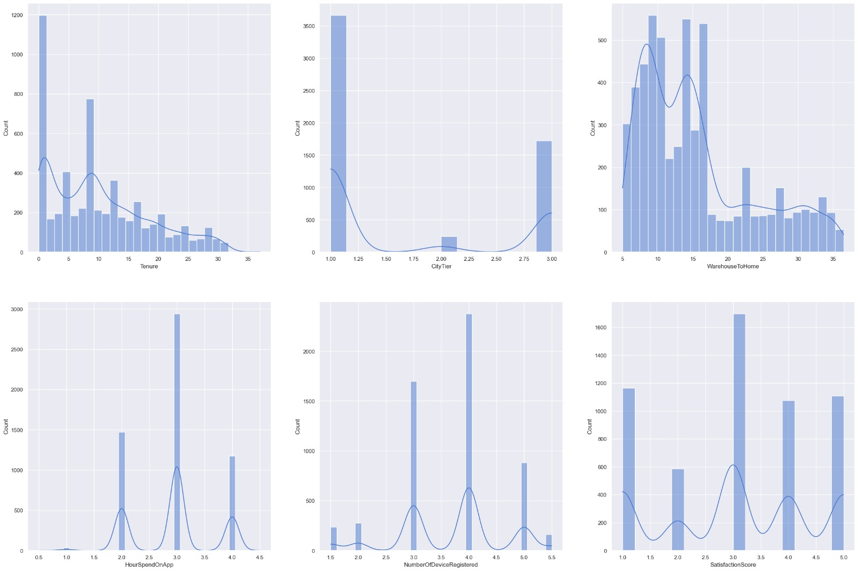
Project analysis slide 2
CONTD…..

Slide 19
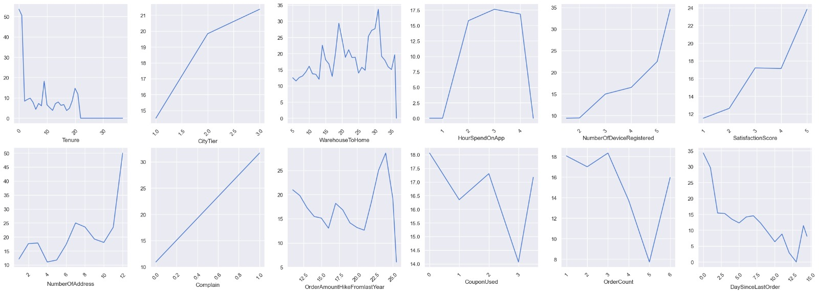
Project analysis slide 2
CONTD…..

Slide 20
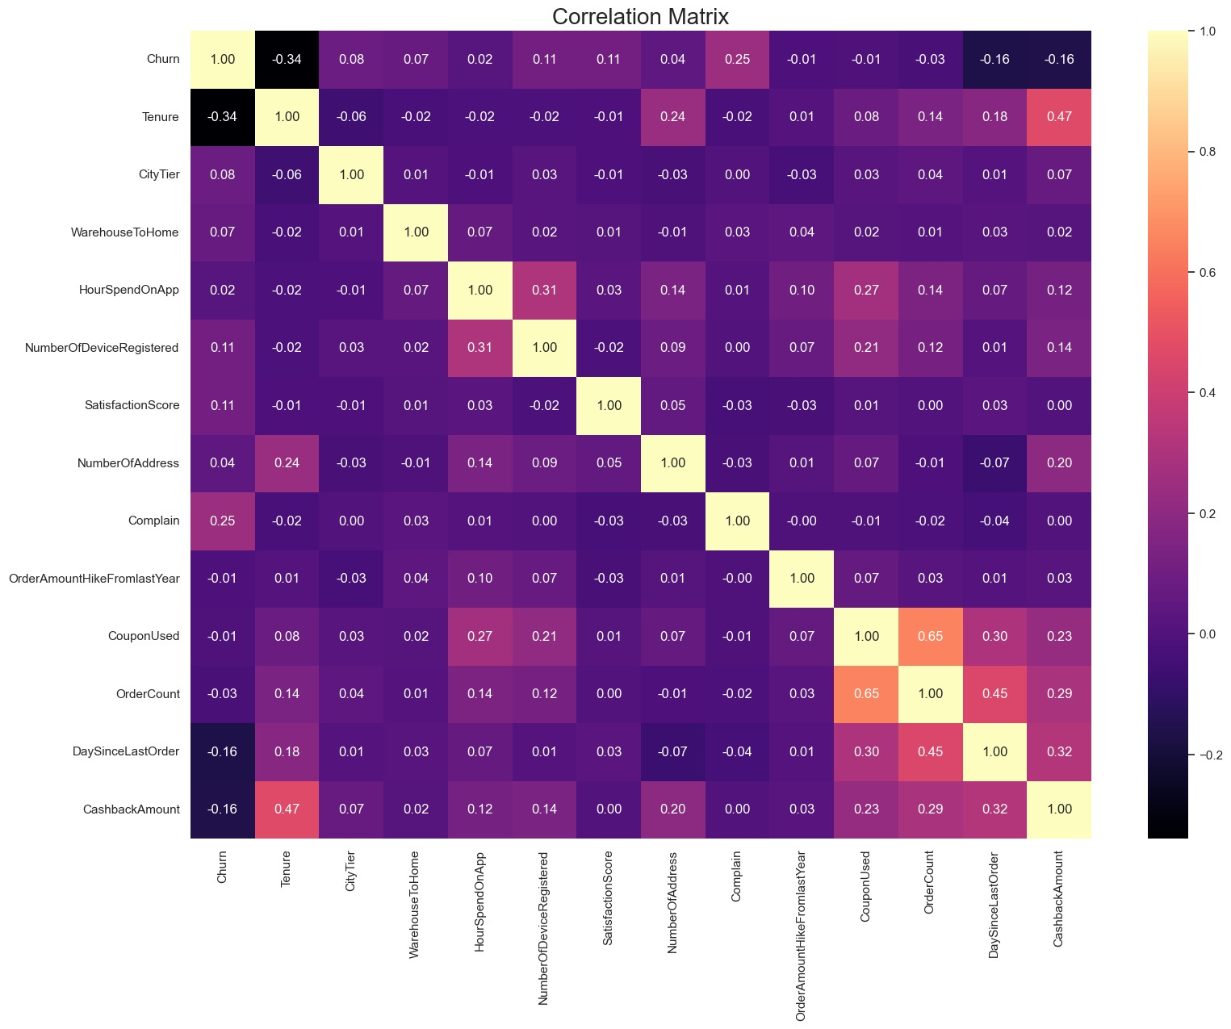
Project analysis slide 2
Correlation

Slide 21
Project analysis slide 2
Previously used classification techniques:
There are several types of classification algorithms. We can use depending on the dataset we’re working with.
These are the classification algorithms, we have used for training our model to evaluate the performances of these models.
Logistic Regression
Naive Bayes
Decision Tree
Support Vector Machines(SVM)

Slide 22
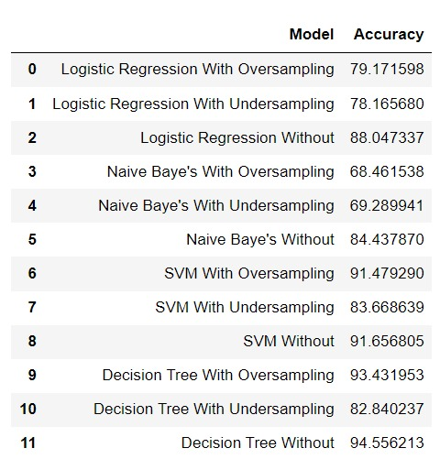
Project analysis slide 8
Classification results of above classifiers :

Slide 23
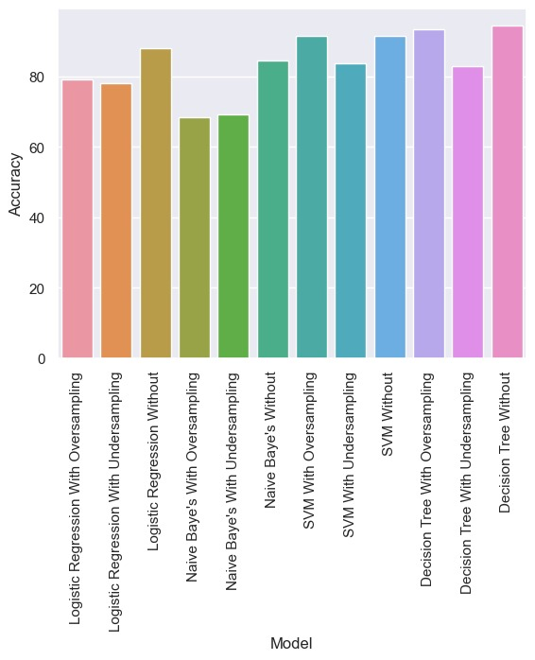

Project analysis slide 8
Classification results of above classifiers :
Here we can observe that the model trained on Decision Tree without sampling data is giving us the highest accuracy.

Slide 24
Project analysis slide 8
Conclusions
By analysing the data, we can conclude that there are few columns which have impacts on Churn both positively as well as negatively.
Negatively correlated with Churn : Tenure, DaySinceLastOrder, CashbackAmount.
Positively correlated with Churn : Complain, SatisfactionScore, NumberOfDeviceRegistered.
As we can observe that there are few classifier models who work well on under sampled data, some work well with over sampled data and work well without sampled data.
After observing the accuracy of each classification algorithm, we can conclude that the models which are trained on Decision Tree has the highest accuracy of 94.556% without over sampled.

Slide 25
Thank You

